Slide 1
Energy indicators of economic advancement
DATA 101 Fall 25
Project 1 – R Miranda

Slide 2
Background on energy and economic impact
Energy types: fossil (oil, gas, coal), renewable (biomass, hydroelectric, wind, solar), nuclear. Electricity is accounted for separately from the other types.
Energy consumption (use): measure of economic growth.
Energy production: relates to consumption for countries that export energy.
National GDP: measure of economic strength and growth for countries.
GDP per capita: measure of standard of living of individuals (personal opinion).

Slide 3
Which is the leading question?
QUESTION: how are energy consumption, production, GDP, and GDP per capita correlated?
Why is it important?
Understanding the relation is key to making better policy decisions on investment in energy research and development.

Slide 4
Which dataset was used
Energy dataset was obtained from Our World in Data: ourworldindata.org/energy
It currently contains 130 variables and 23195 rows for 165 countries, 1 row per year. World records before 1960 are very sparse. So effectively, most data is for 1960-2024.

Slide 5
Selected variables (15)
Country, iso_code
Year
Population
Energy_per_capita: consumption in KWh/capita
Primary_energy_consumption: total TWh/country/year
(Each fossil energy: coal, oil, gas)
Electricity_generation: total TWh/country/year
(Fractions of each fossil and nuclear energies converted to electricity)
GDP: international $; WB-adjusted for inflation and cost of living for each country

Slide 6
Data wrangling and analysis
1. Cleaning NAs, countries column, adding variables.
2. How is GDP/capita and energy consumption/capita (i.e., standard of living) distributed across nations and years? summarize() / histogram
3. Is there correlation between national GDP, total energy consumption, total energy production, GDP/capita, energy consumption/capita? cor()
4. How have energies and GDP progressed since 1960? Lumped rows by decade, calculated basic statistics by decade
5. How are countries distributed according to GDP/capita? Binned gdp/capita into 6 bins / histogram _ show contributions from each decade
6. How have total energies and national GDP evolved in time? Scatterplot
7. How nations rank in GDP/capita and energies? Summarize table / cor()

Slide 7
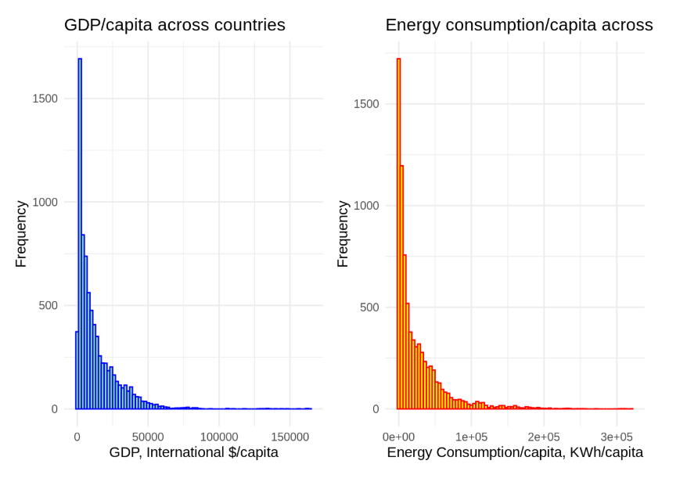
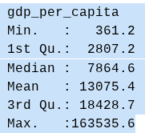
Results
Strongly right skewed

Slide 8
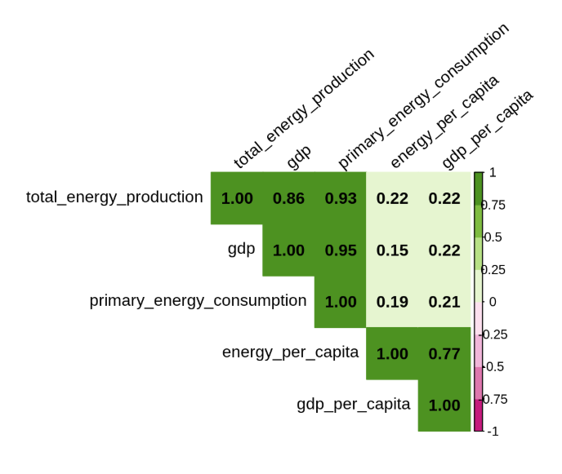
Correlations
-Production-consumption .93
-GDP-consumption .95
-GDP-production .86
-Energy/capita or GDP/capita do not correlate strongly with GDP or energies!

Slide 9
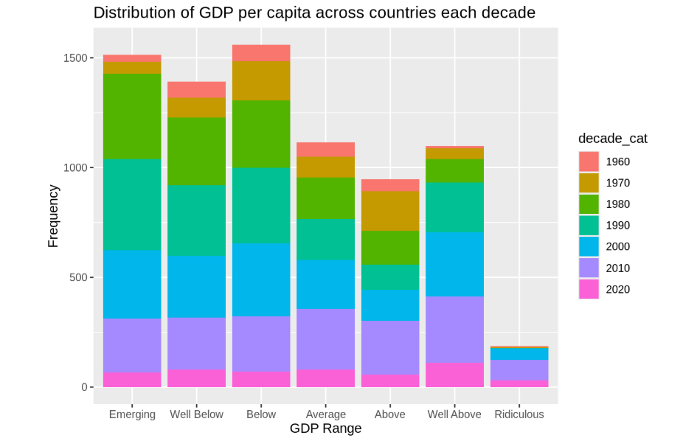
GDP/cap bins:
Emerging
360-2000
Well Below 2000-5000
Below
5000-10000
Average 10000-16000
Above
16000-25000
Well Above 25000-50000
Ridiculous
50000-inf

Slide 10
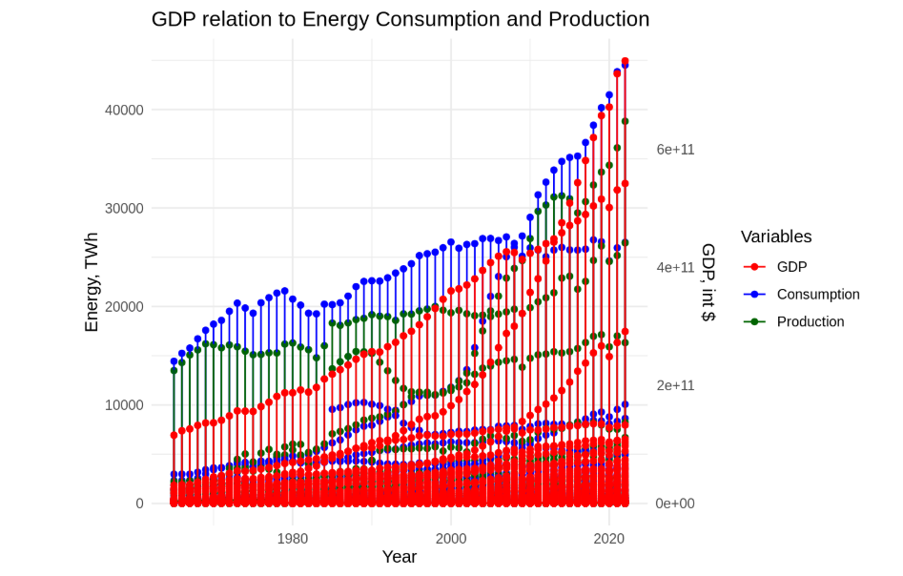

Slide 11
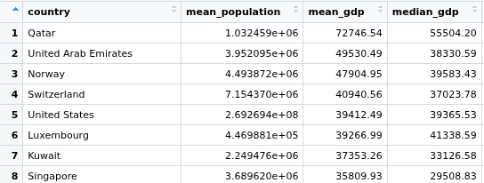
How countries rank in GDP/capita

Slide 12
Conclusions
GDP of countries correlate better with energy consumption than with production
GDP per capita and energy consumption per capita (std of living) are poorly correlated with national GDP (size of the economy) or energy production. GDP/capita is inversely related to population size.
5 / 8 of GDP/cap are in the emerging up to average ranges, 2 / 8 as above to well above average, and 1 / 8 as ridiculous.
Energy and GDP evolution: 1960s modest for all countries; 80s, 90s, 00s very good for the emerging, well below and below average economies. 2010 and 20s very good for well above and ridiculous economies.
Time evolution curves: exponential growth after 1980; consumption follows production. – this needs more analysis.

